Slide 1
The Ending Cancer in Our Generation Foundation
A Community of artists promoting cancer awareness and survivorship through their mediums
2012 Annual Report

Slide 2
The Ending Cancer in Our Generation Foundation
T
H
A
N
K
Y
O
U
The Ending Cancer in Our Generation Foundation is a community for anyone affected by cancer to come together and make connections and promote awareness and survivorship through art. We are striving to build a comprehensive online community for all. We would like to take a moment to thank everyone who helped us in our second year. Without your support, we would not be here.

Slide 3
The Ending Cancer in Our Generation Foundation
As we rounded out our second formal year of existence for the Ending Cancer in Our Generation Foundation, we accomplished many large items in our calendar year
Date | Accomplishment
May 1st , 2012 | Base Location Moves
July 26th, 2012 | Website Rolls Out
August 22nd, 2012 | Print Fundraiser Launched
September 1st, 2012 | 2012 Benefit Starts
September 31st, 2012 | 2012 Benefit Ends
November 5th, 2012 | First Set of t-Shirts Designed
December 31st, 2012 | Tax Year End

Slide 4
The Ending Cancer in Our Generation Foundation
Our Future Goals for 2013
For 2013, our annual benefit will be again be held through ebay. With this event style we will be able to reach a larger audience and hopefully raise more funds for our organization.
We will hopefully be awarding two scholarships in August 2013. We are currently accepting applications and have quite a few great applicants.

Slide 5
The Ending Cancer in Our Generation Foundation
Statement of Financial Position For years ending December 31st
Assets |  | 2012 |  | 2011
Cash and Cash Equivalents |  | $617 |  | $1,187
Program Service Revenue- Annual Benefit |  | $ 1111 |  | $324
Total Assets |  | $1728 |  | $1,511
Liabilities (Deficit) |  | 2012 |  | 2011
Office Expenses/Costs |  | $50 |  | $345
Other Adminstrative Expenses |  | $1244 |  | $771
Total Liabilities |  | 1294 |  | $1,116
Total Assets or Fund Balances |  | 434 |  | $395

Slide 6
The Ending Cancer in Our Generation Foundation
Revenue |  | Total (US $)
Public Contributions |  | $577
2012 Benefit |  | $1111
2012 Print Fundraiser |  | $40.00
Total Revenue |  | $1728

Slide 7
The Ending Cancer in Our Generation Foundation
Expense |  | Total (US $)
Salary- Annual Stipend |  | $50.00
2012 Benefit |  | $436
Print Fundraiser |  | $254
Office Expenses |  | $223
Advertising |  | 97
Meeting Expenses |  | 184
Fees |  | 50
Total Expenses |  | $1294

Slide 8
The Ending Cancer in Our Generation Foundation
We would like to thank our Sponsor for the 2012 Benefit
Lagomorph Studios
We would like to thank our Individual Sponsors for the 2012 Benefit
Matthew Fish, Jetty Kircher,, Melonie Bariola Jayne Ananias, Clyde and Jessie Cummings, Janet Davis
We had many donations that were placed in our Spring
Fundraiser, please look for the acknowledgments in next years Annual Report

Slide 9
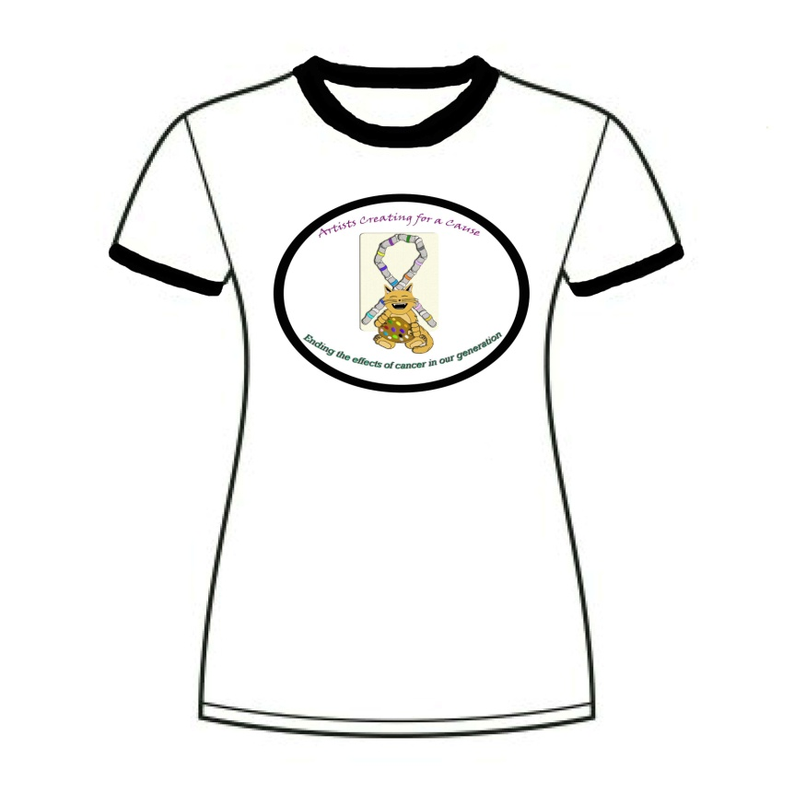
The Ending Cancer in Our Generation Foundation
We will be Approaching some big new fundraiser events in 2013. Keep and eye out for T-Shirts, Donations Rewards and more!

Slide 10
The Ending Cancer in Our Generation Foundation Board of Directors
Jetty Ann Kircher
Matthew Fish
DaShawn Hall
Jacob Hendricks
Young woo Song

